Slide 1
Physics-informed Machine Learning for Solving Forward and Inverse 3D Multi-layered Consolidation Problems
QUIRK London University Physics Conference
Umar Siddique (UCL)
15/02/2025

Slide 2
Physics-informed Deep Learning

Slide 3



Slide 4
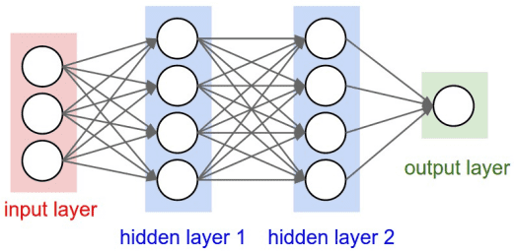
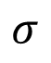
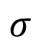
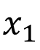
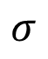
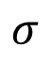
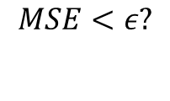
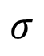
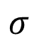
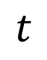
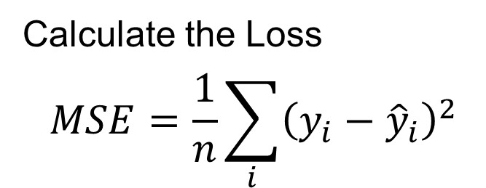
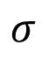
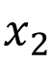
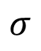
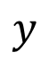
Neural Network
The feed-forward neural network is constructed and trained using input data. The model will train the weights by minimising the loss function
Neurons within these layers are interconnected, adjusting weights and biases through training to improve accuracy
Feed Forward
$$σ$$
$$σ$$
$$x_{1}$$
$$σ$$
$$σ$$
$$x_{2}$$
$$y$$
$$σ$$
$$σ$$
$$t$$
$$σ$$
$$σ$$
Calculate the Loss
$$MSE=\frac{1}{n}\sum_{i}{{\left(y_{i}−{\hat{y}}_{i}\right)}^{2}}$$
Update
weights
No
$$MSE<ε?$$
Finish
Yes

Slide 5
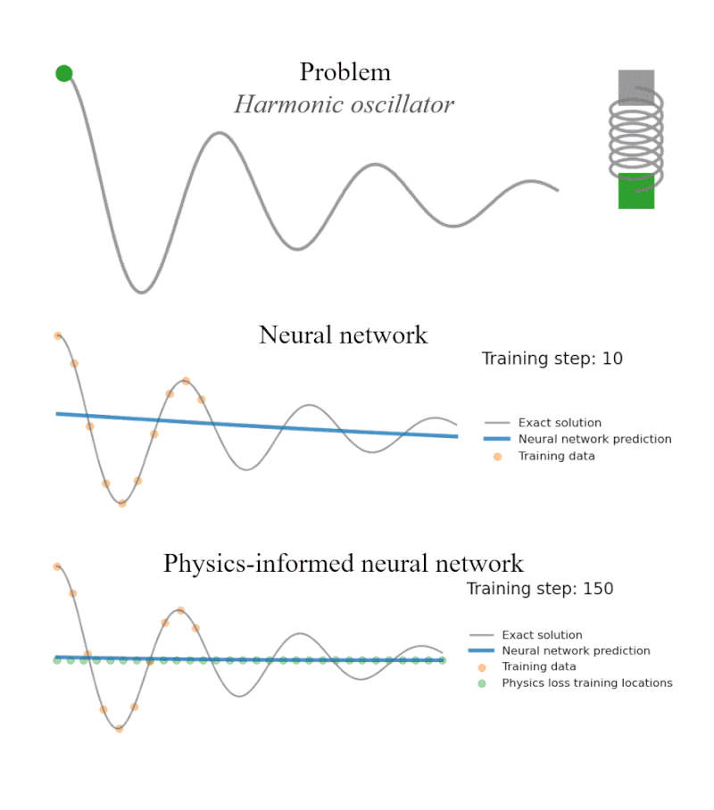
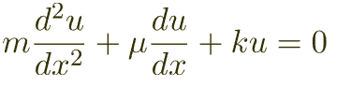
Harmonic Oscillator
Source: https://benmoseley.blog/

Slide 6
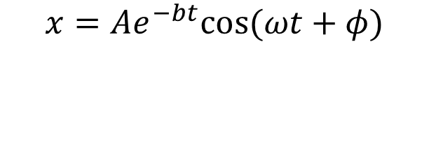
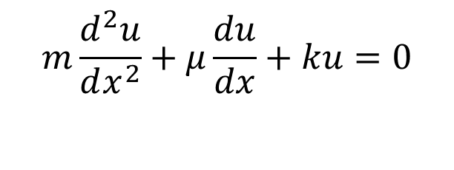
Harmonic Oscillator
$$x=Ae^{−bt}cos⁡(ωt+φ)$$
$$m\frac{d^{2}u}{dx^{2}}+μ\frac{du}{dx}+ku=0$$

Slide 7
Forward Problem
Developing a surrogate model to solve 3D consolidation problems

Slide 8
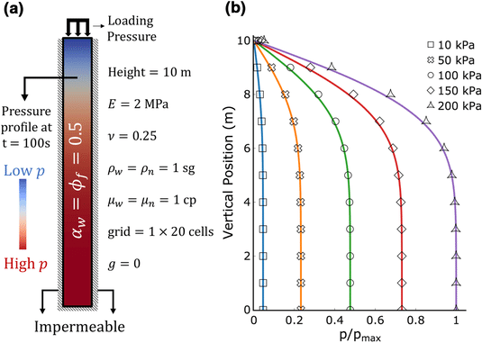
The Terzaghi Problem in 1D
Karl von Terzaghi introduced the idea in a series of papers in the 1920s based on his examination of building consolidation on soil.
The problem is one-dimensional, the only gradient being in the vertical direction.
The purpose of the analysis is to predict the evolution of displacement, effective stress, and pore pressure throughout the soil as a function of time following the load application.
Pore pressure refers to the pressure exerted by fluids within the tiny spaces ("pores") between soil particles or rock grains

Slide 9
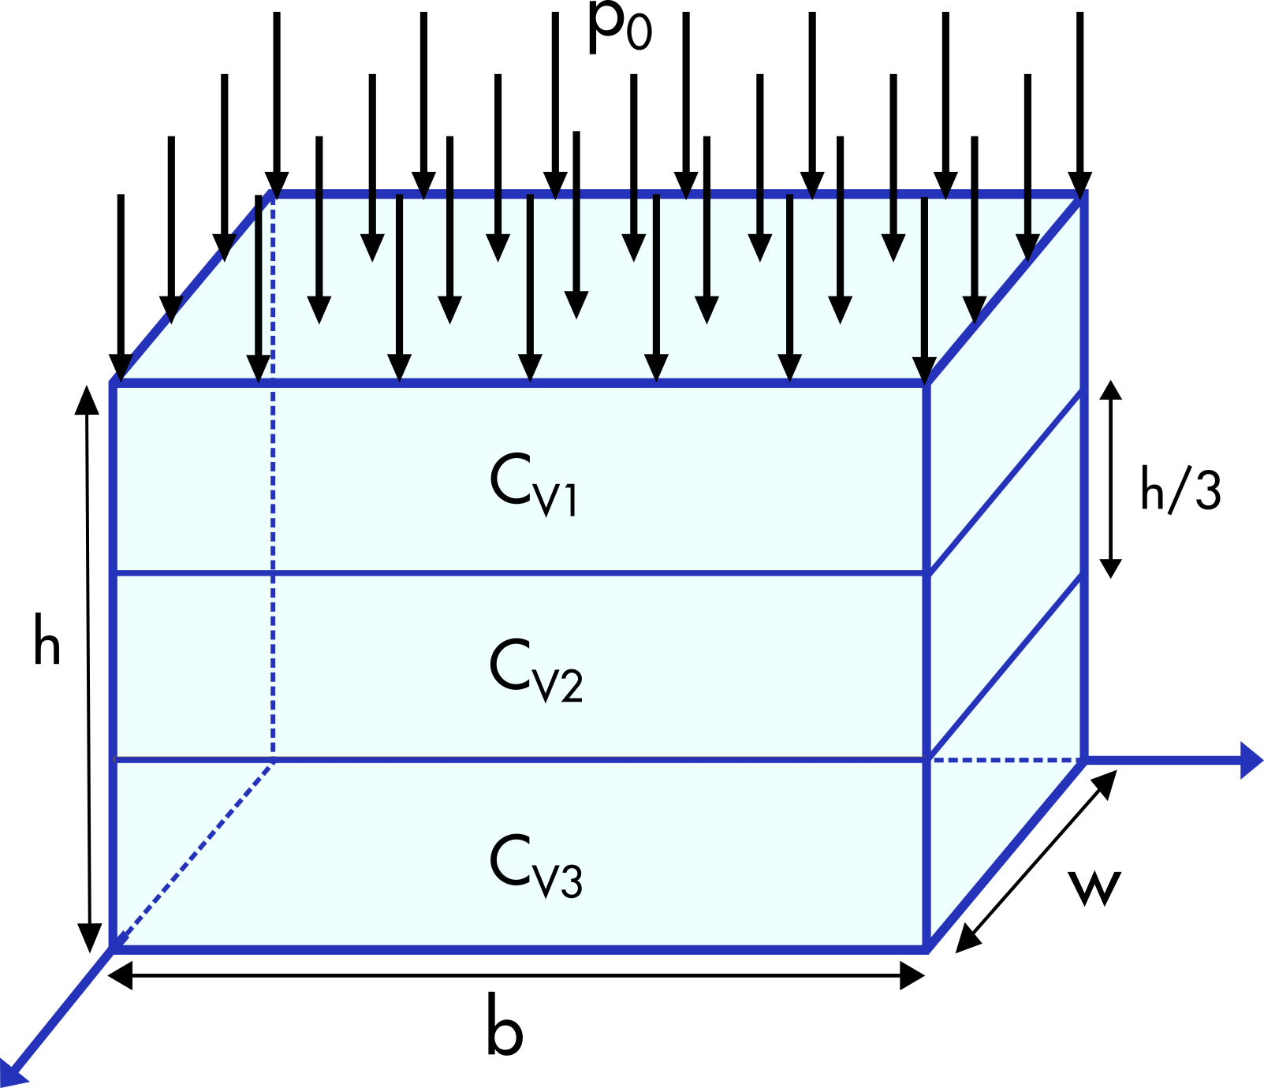

The Terzaghi Problem in 3D
Extension to the 1D Problem
Rendulic expanded the one-dimensional consolidation theory to two and three dimensions, introducing the Terzaghi–Rendulic theory.
This theory assumes that during consolidation under constant external loads, the sum of normal stresses at any point in the soil remains constant.
Consequently, the consolidation problem becomes analogous to the thermal diffusion problem, with its mathematical representation referred to as the diffusion equation.
$$\begin{matrix}c_{v1} & \text{for} \frac{2}{3}<z<1, \\ c_{v2} & \text{for} \frac{1}{3}<z<\frac{2}{3}, \\ c_{v3} & \text{for} 0<z<\frac{1}{3}\end{matrix}$$

Slide 10
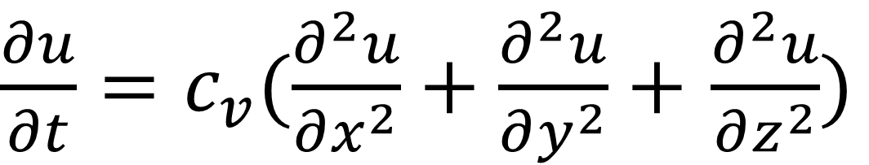
The Terzaghi Equation in 3D
$\frac{∂u}{∂t}=c_{v}(\frac{∂^{2}u}{∂x^{2}}+\frac{∂^{2}u}{∂y^{2}}+$ $\frac{∂^{2}u}{∂z^{2}})$

Slide 11
Solving the Terzaghi PDE
Lattice Boltzmann Method
Finite Element Method (FEM)
Fourier Series
(1D Only)
$\frac{∂u}{∂t}=c_{v}(\frac{∂^{2}u}{∂x^{2}}+\frac{∂^{2}u}{∂y^{2}}+$ $\frac{∂^{2}u}{∂z^{2}})$
Finite Volume Method (FVM)
Finite Difference Method (FDM)
Smoothed Particle Hydrodynamics

Slide 12
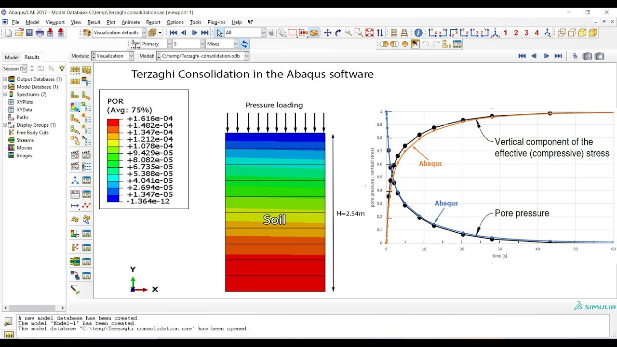
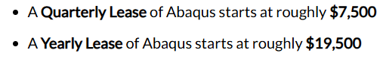
Abaqus

Slide 13
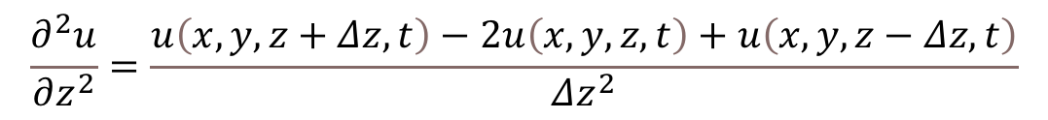
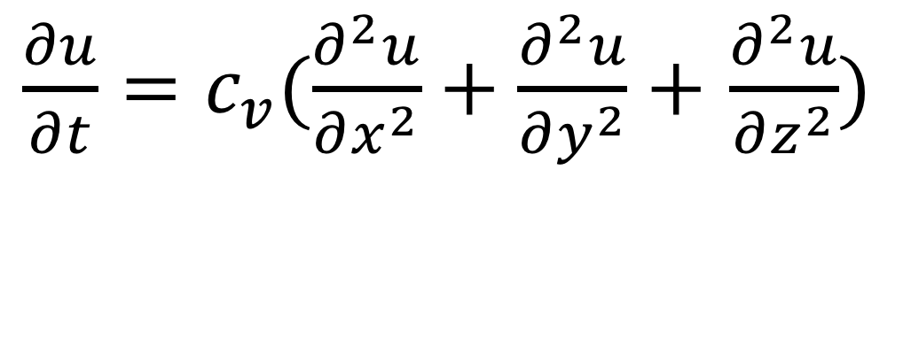

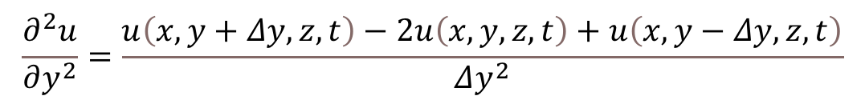
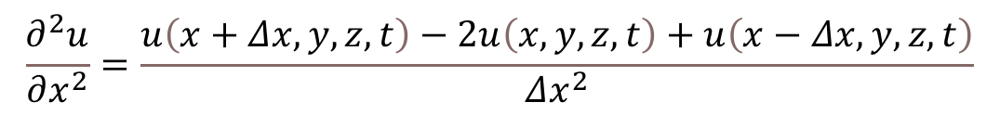
Central-Order Difference Method
$\frac{∂u}{∂t}=c_{v}(\frac{∂^{2}u}{∂x^{2}}+\frac{∂^{2}u}{∂y^{2}}+$ $\frac{∂^{2}u}{∂z^{2}})$
$$\frac{∂^{2}u}{∂x^{2}}=\frac{u\left(x+Δx,y,z,t\right)−2u\left(x,y,z,t\right)+u\left(x−Δx,y,z,t\right)}{Δx^{2}}$$
$$\frac{∂u}{∂t}=\frac{u\left(x,y,z,t+Δt\right)−u\left(x,y,z,t\right)}{Δt}$$
$$\frac{∂^{2}u}{∂y^{2}}=\frac{u\left(x,y+Δy,z,t\right)−2u\left(x,y,z,t\right)+u\left(x,y−Δy,z,t\right)}{Δy^{2}}$$
$$\frac{∂^{2}u}{∂z^{2}}=\frac{u\left(x,y,z+Δz,t\right)−2u\left(x,y,z,t\right)+u\left(x,y,z−Δz,t\right)}{Δz^{2}}$$

Slide 14
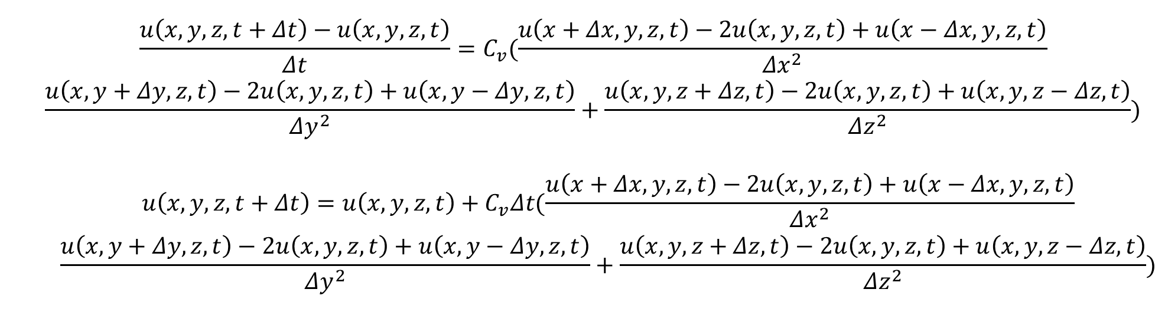
Central-Order Difference Method
$\frac{∂u}{∂t}=c_{v}(\frac{∂^{2}u}{∂x^{2}}+\frac{∂^{2}u}{∂y^{2}}+$ $\frac{∂^{2}u}{∂z^{2}})$
$$\begin{matrix} & \frac{u\left(x,y,z,t+Δt\right)−u\left(x,y,z,t\right)}{Δt}=C_{v}(\frac{u\left(x+Δx,y,z,t\right)−2u\left(x,y,z,t\right)+u\left(x−Δx,y,z,t\right)}{Δx^{2}} \\ & \begin{aligned}\frac{u\left(x,y+Δy,z,t\right)−2u\left(x,y,z,t\right)+u\left(x,y−Δy,z,t\right)}{Δy^{2}}+\frac{u\left(x,y,z+Δz,t\right)−2u\left(x,y,z,t\right)+u\left(x,y,z−Δz,t\right)}{Δz^{2}}) \\ \\ \begin{matrix} & u\left(x,y,z,t+Δt\right)=u\left(x,y,z,t\right)+C_{v}Δt(\frac{u\left(x+Δx,y,z,t\right)−2u\left(x,y,z,t\right)+u\left(x−Δx,y,z,t\right)}{Δx^{2}} \\ & \begin{aligned}\frac{u\left(x,y+Δy,z,t\right)−2u\left(x,y,z,t\right)+u\left(x,y−Δy,z,t\right)}{Δy^{2}}+\frac{u\left(x,y,z+Δz,t\right)−2u\left(x,y,z,t\right)+u\left(x,y,z−Δz,t\right)}{Δz^{2}}) \\ \end{aligned}\end{matrix}\end{aligned}\end{matrix}$$

Slide 15
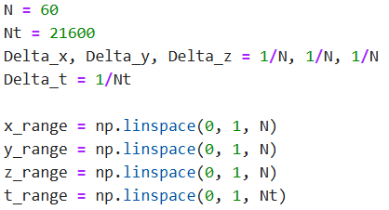
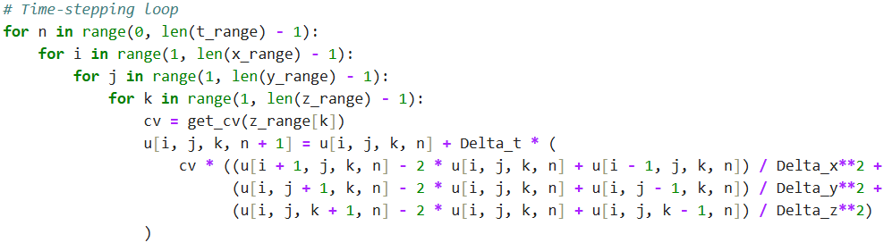
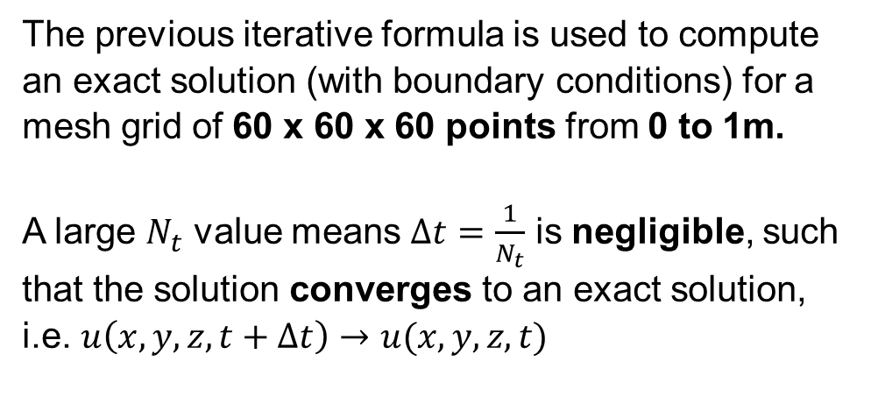
Computing Exact Solution
The previous iterative formula is used to compute an exact solution (with boundary conditions) for a mesh grid of 60 x 60 x 60 points from 0 to 1m.
A large $N_{t}$ value means $Δt=\frac{1}{N_{t}}$ is negligible, such that the solution converges to an exact solution, i.e. $u\left(x,y,z,t+Δt\right)→u(x,y,z,t)$

Slide 16
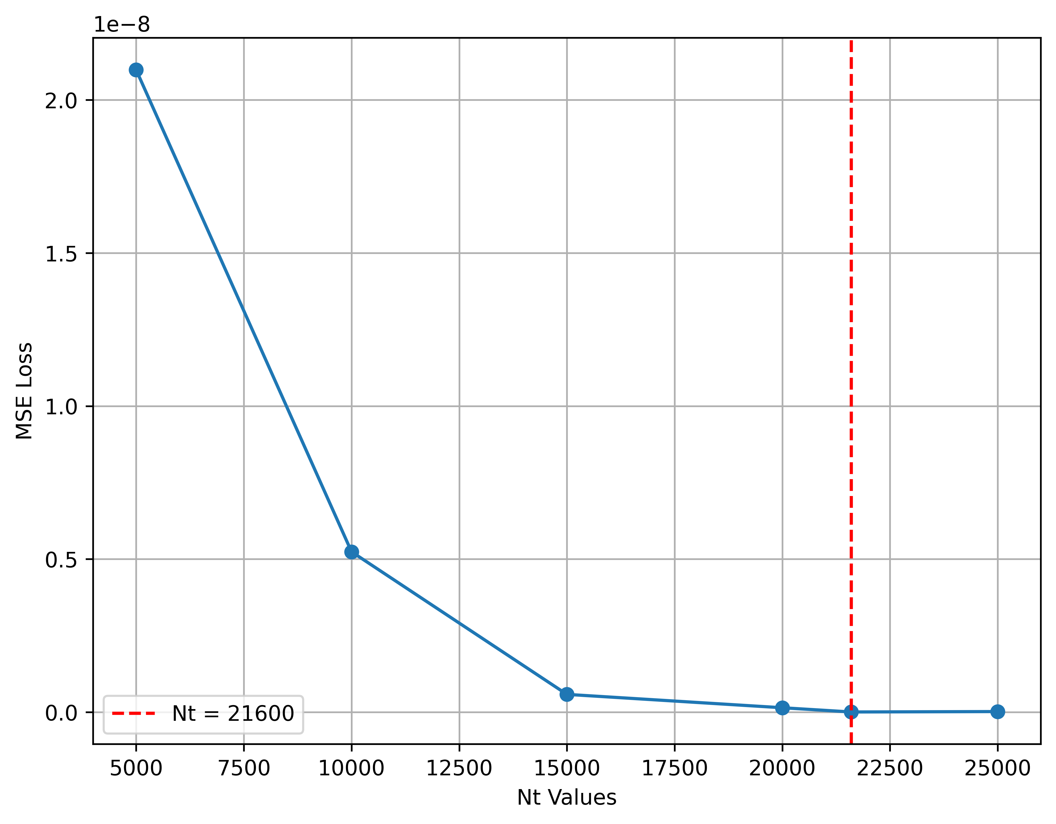
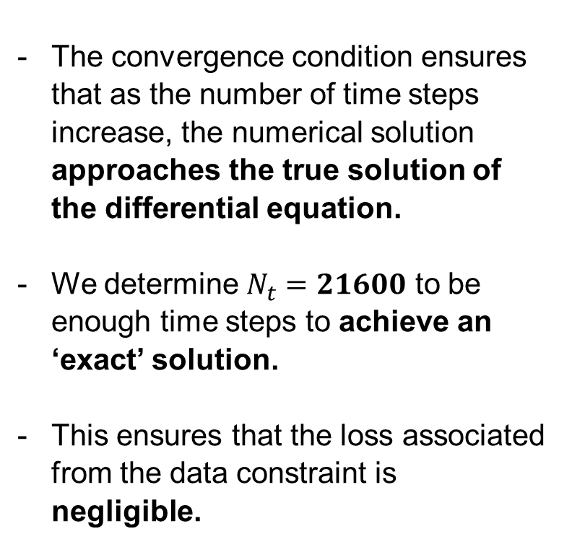
Convergence Condition
The convergence condition ensures that as the number of time steps increase, the numerical solution approaches the true solution of the differential equation.
We determine $N_{t}=21600$ to be enough time steps to achieve an ‘exact’ solution.
This ensures that the loss associated from the data constraint is negligible.

Slide 17
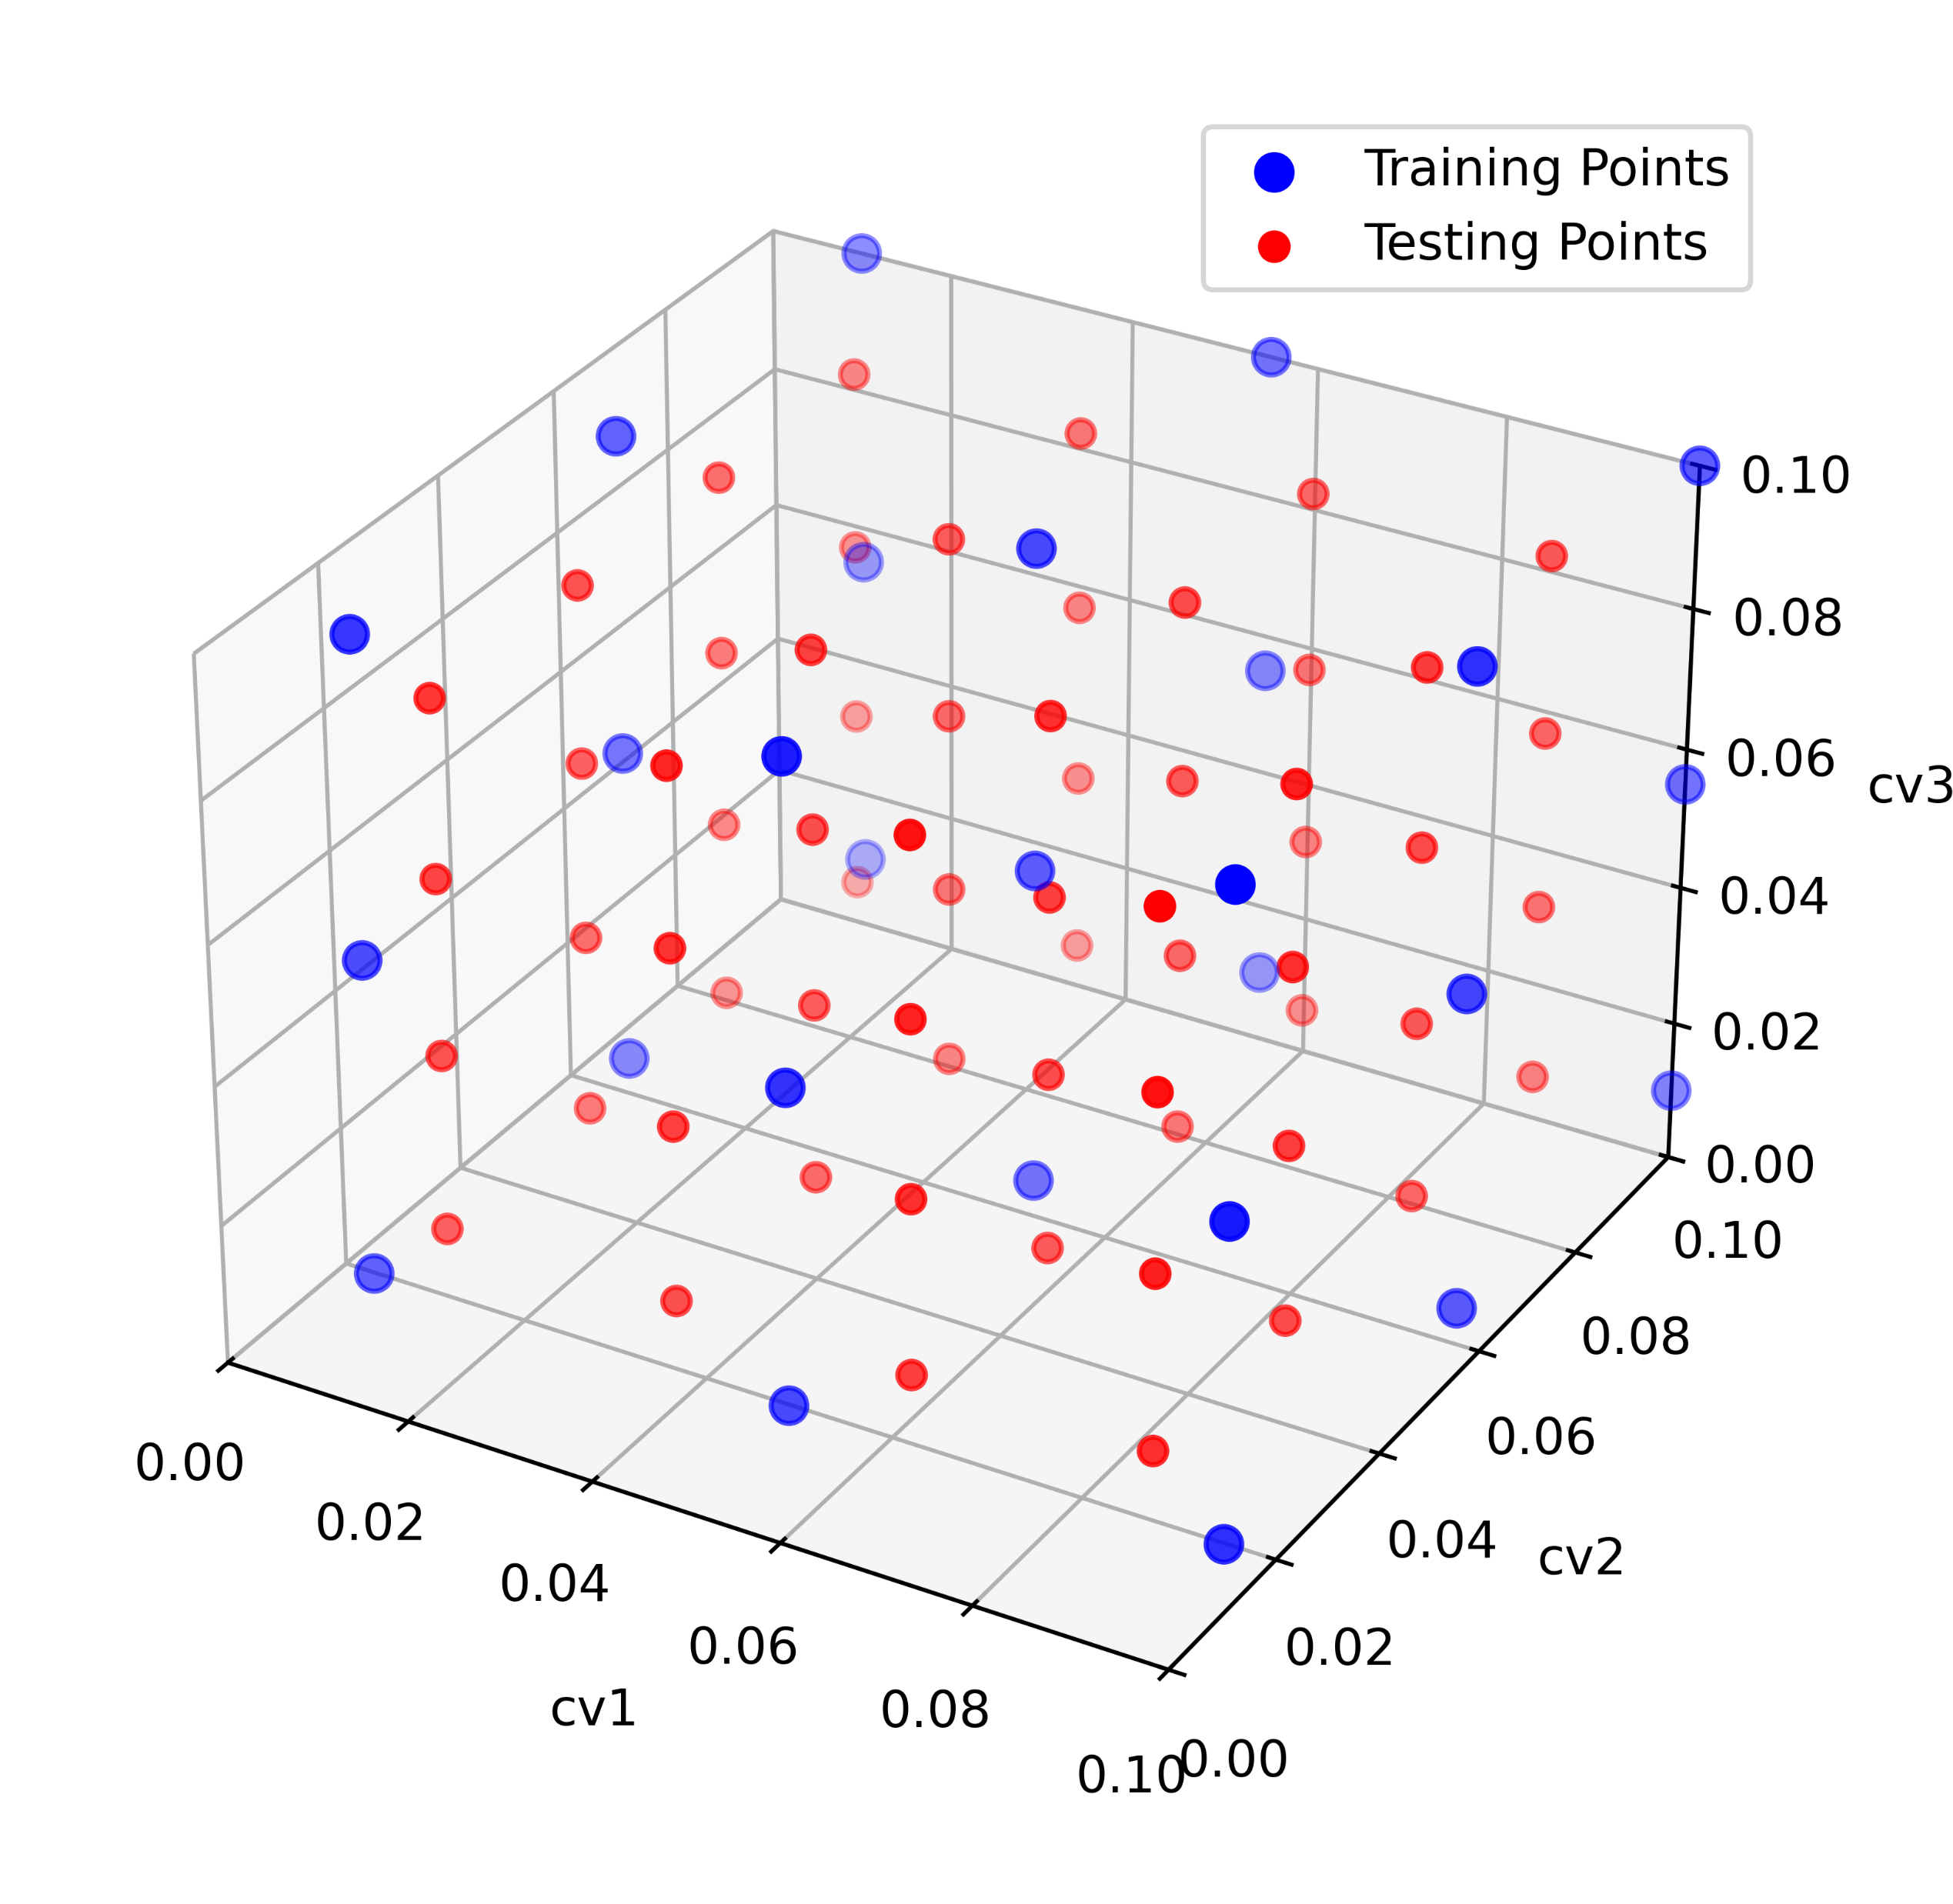
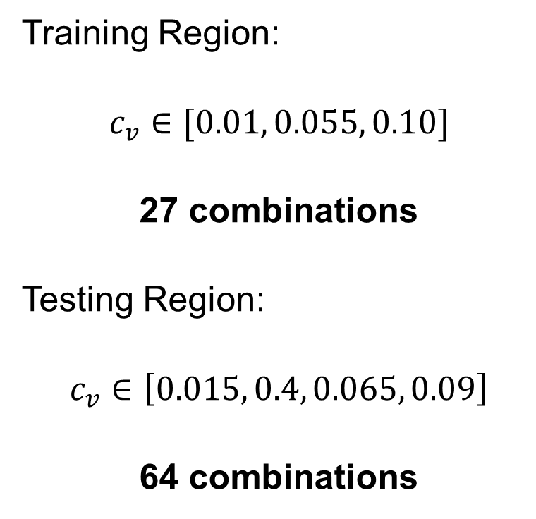
What data do we use for the model?
Training Region:
$$c_{v}∈[0.01, 0.055, 0.10]$$
27 combinations
Testing Region:
$$c_{v}∈\left[0.015, 0.4, 0.065, 0.09\right]$$
64 combinations

Slide 18
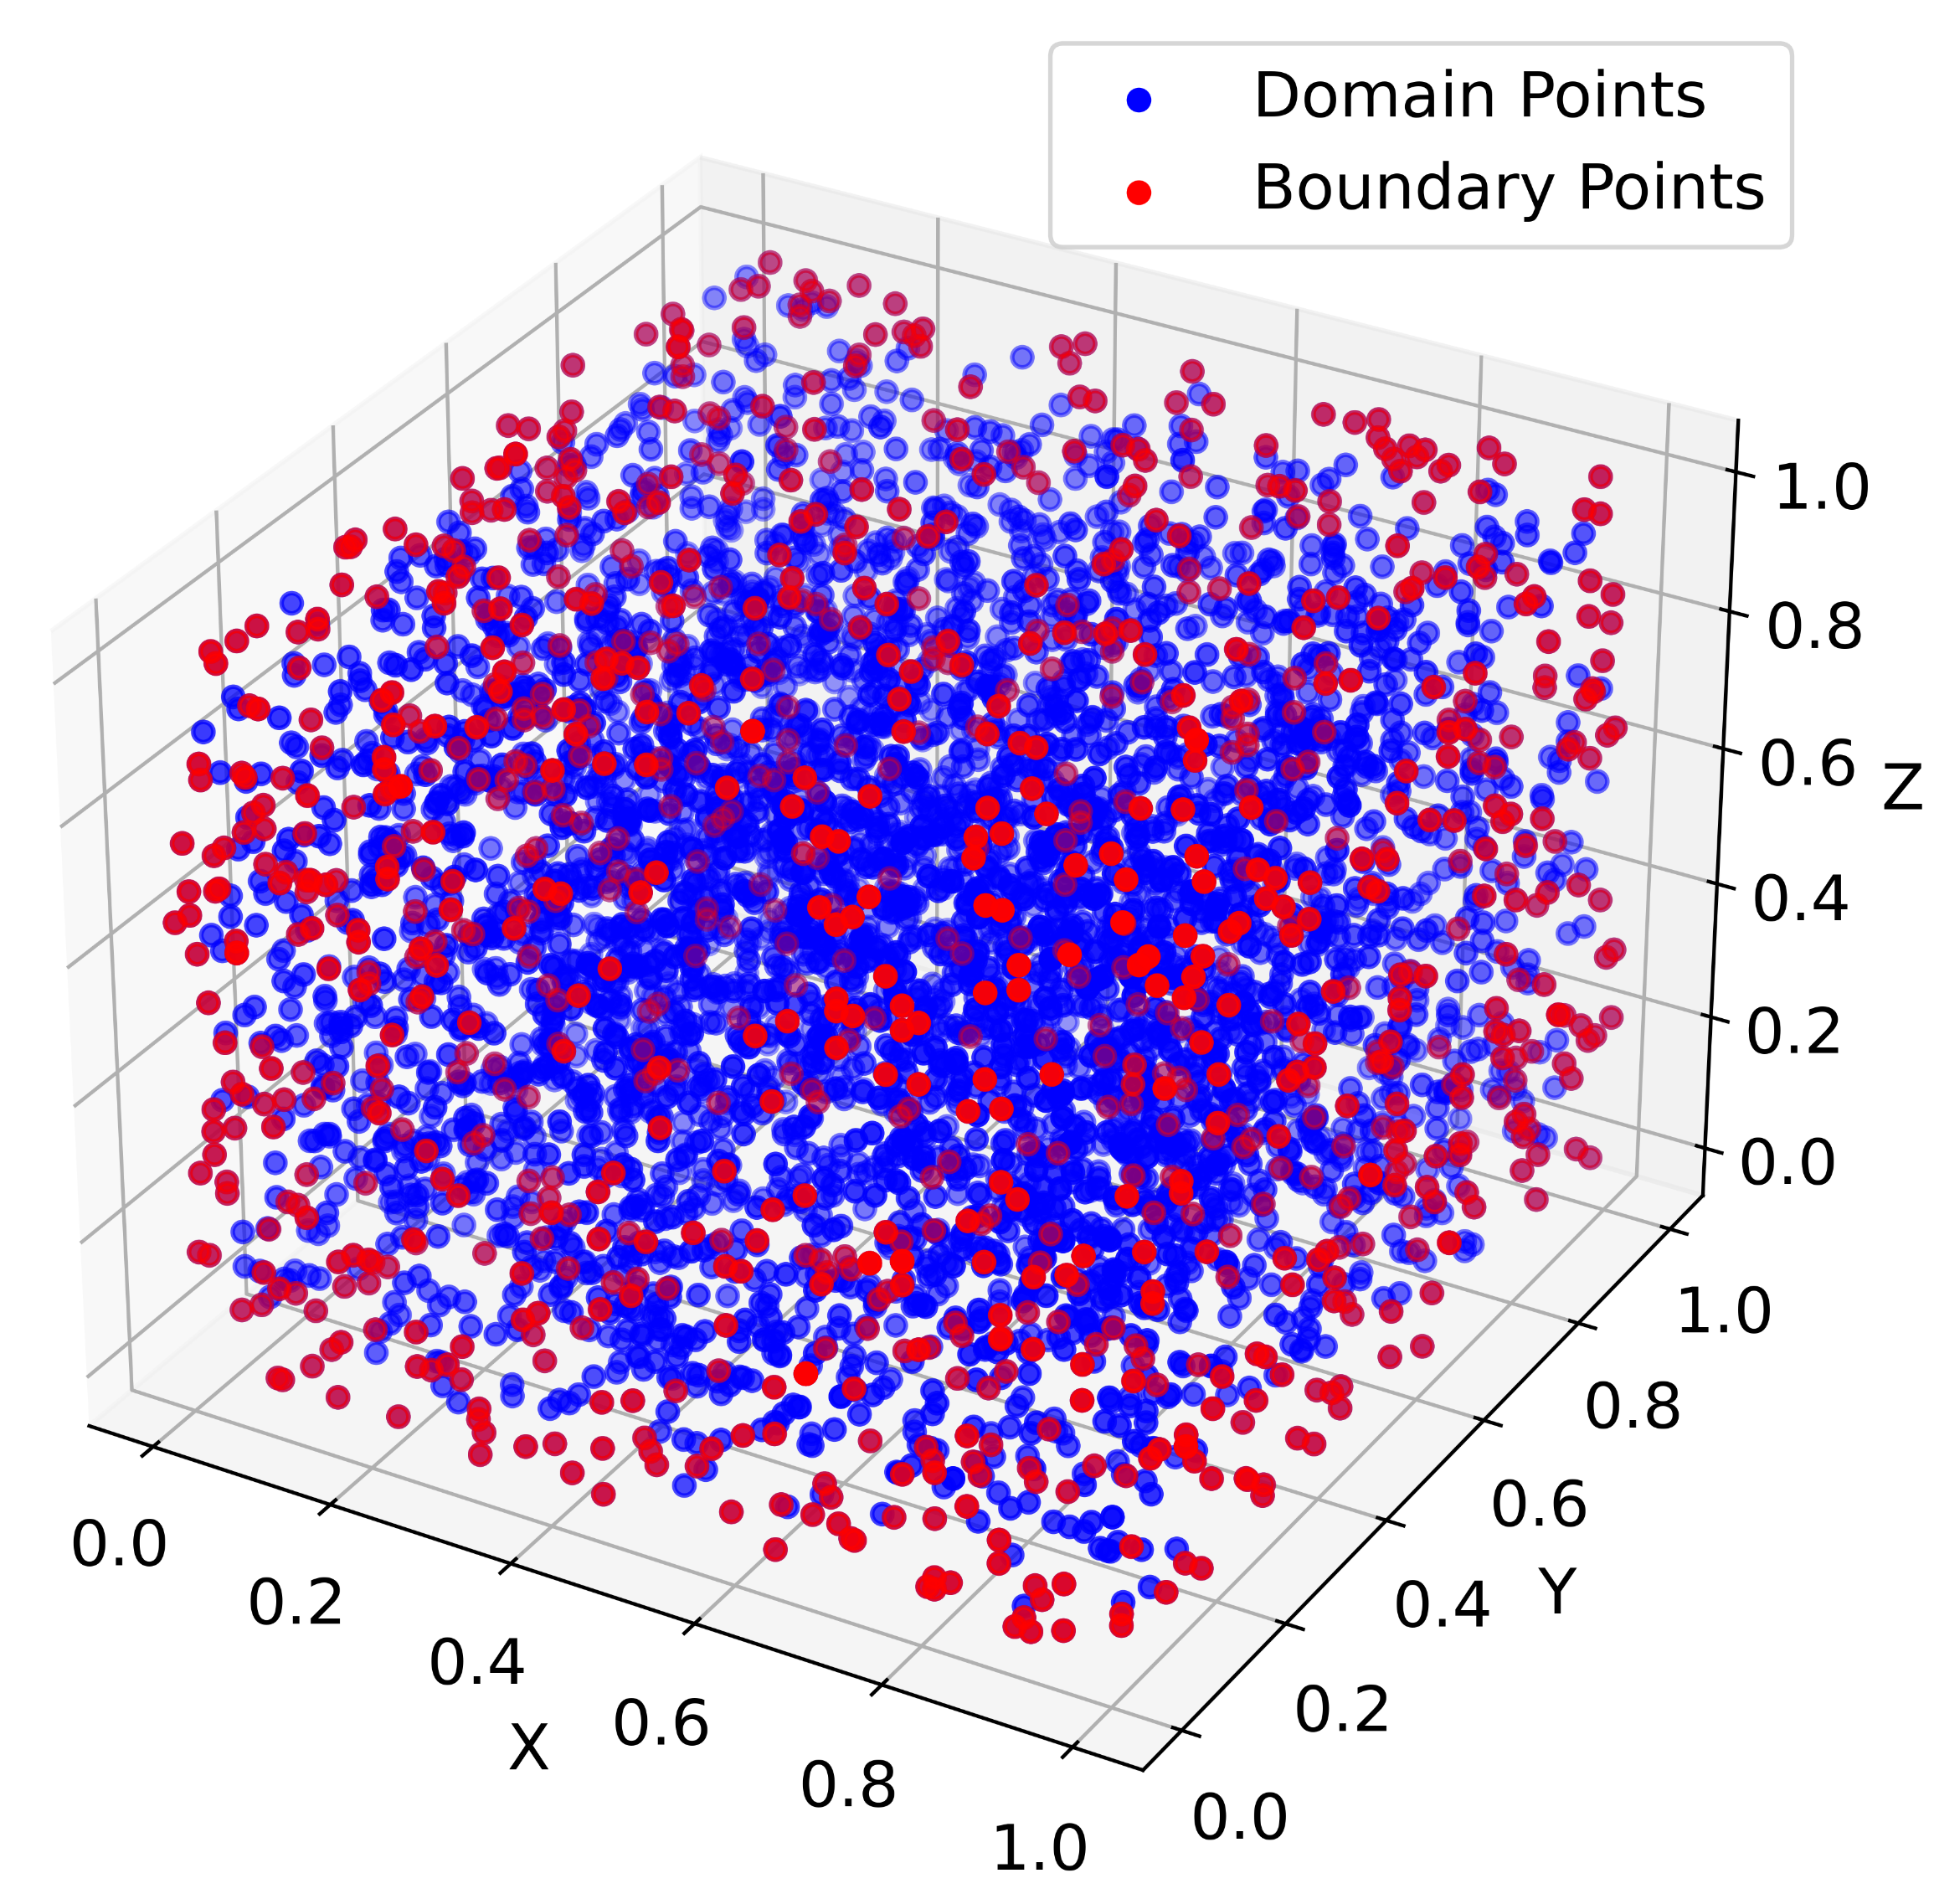
What data do we use for the model?

Slide 19
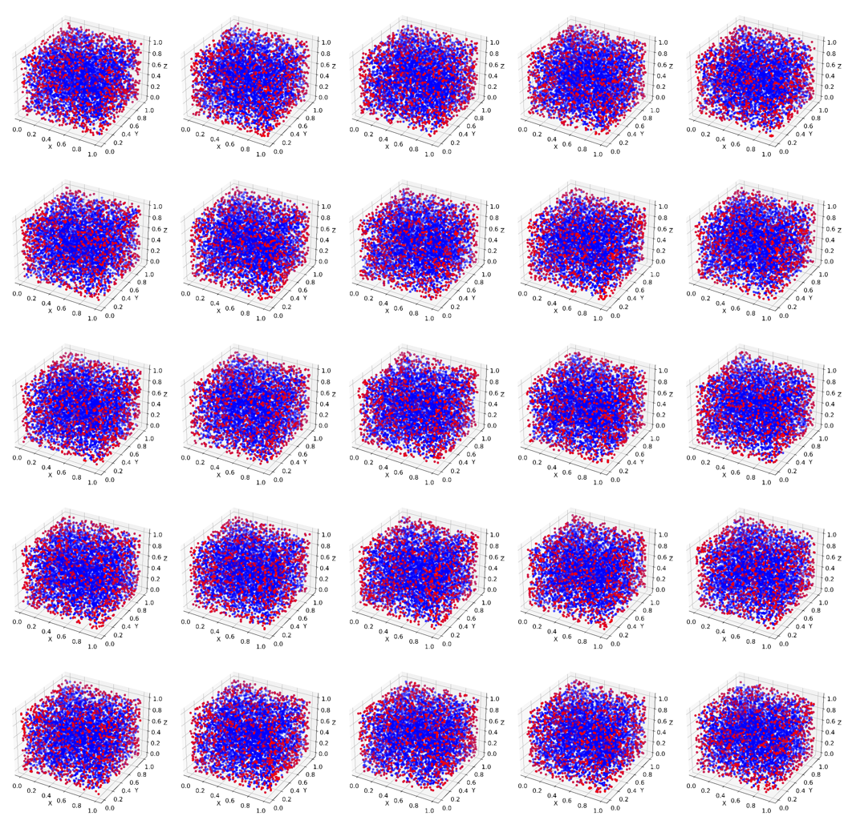
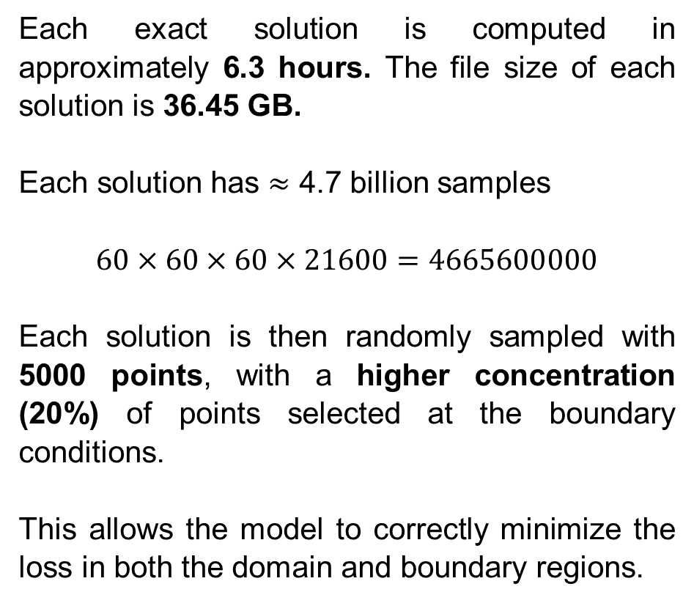
What data do we use for the model?
Each exact solution is computed in approximately 6.3 hours. The file size of each solution is 36.45 GB.
Each solution has $≈$ 4.7 billion samples
$$60×60×60×21600=\text{466560000}\text{0}$$
Each solution is then randomly sampled with 5000 points, with a higher concentration (20%) of points selected at the boundary conditions.
This allows the model to correctly minimize the loss in both the domain and boundary regions.

Slide 20
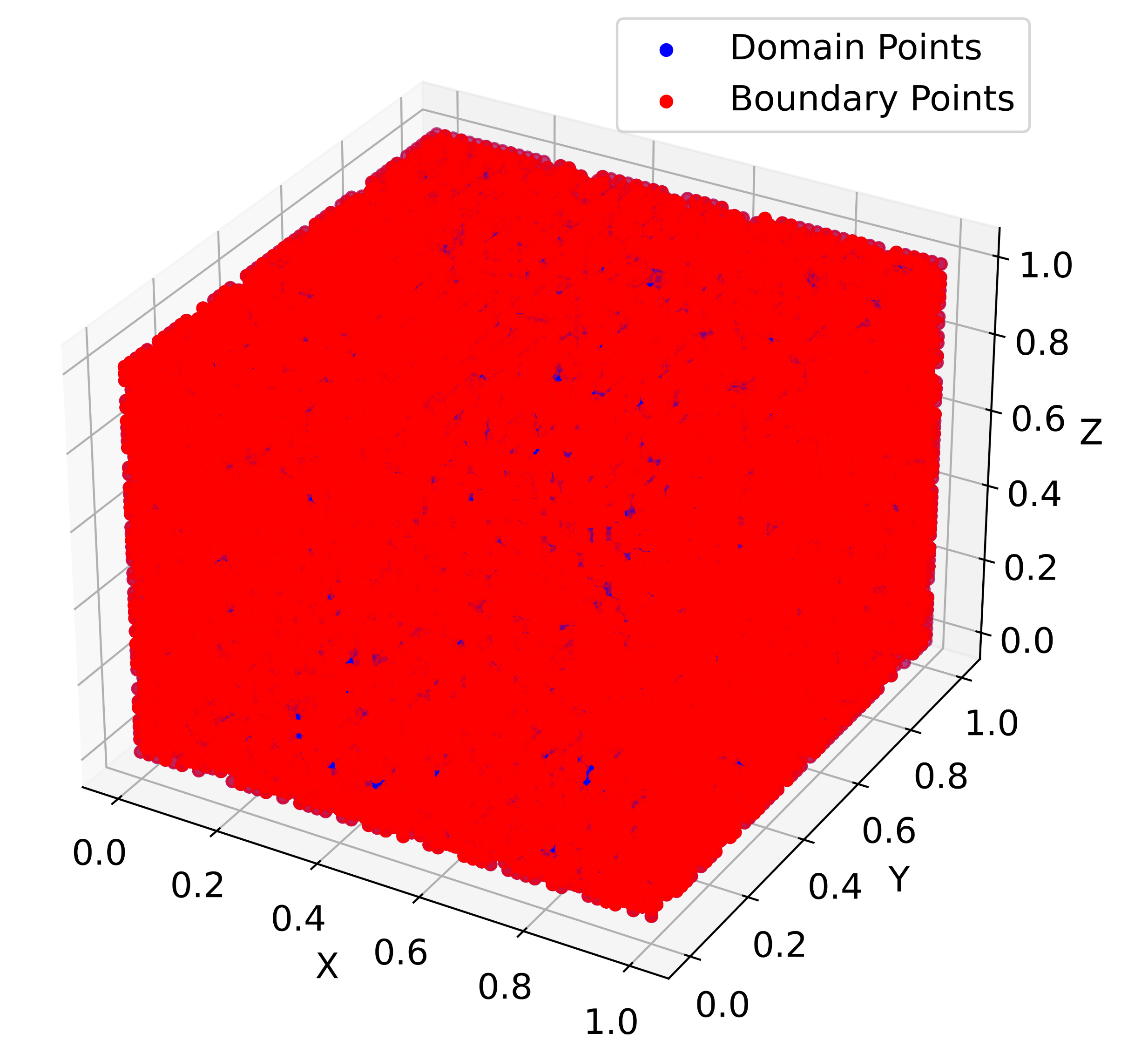
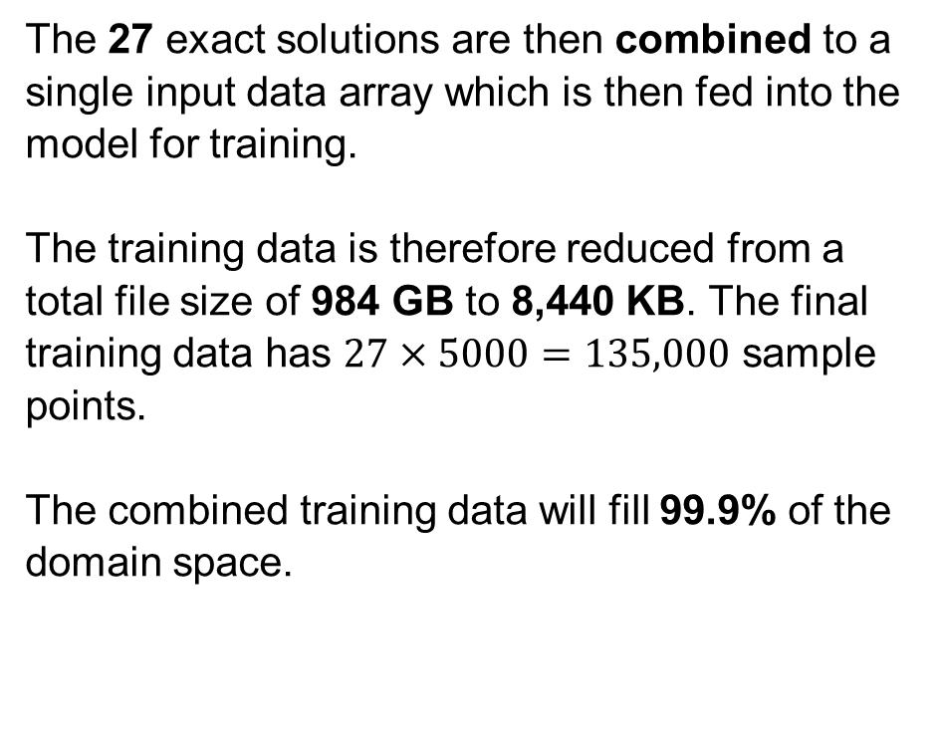
What data do we use for the model?
The 27 exact solutions are then combined to a single input data array which is then fed into the model for training.
The training data is therefore reduced from a total file size of 984 GB to 8,440 KB. The final training data has $27×5000=135,000$ sample points.
The combined training data will fill 99.9% of the domain space.

Slide 21
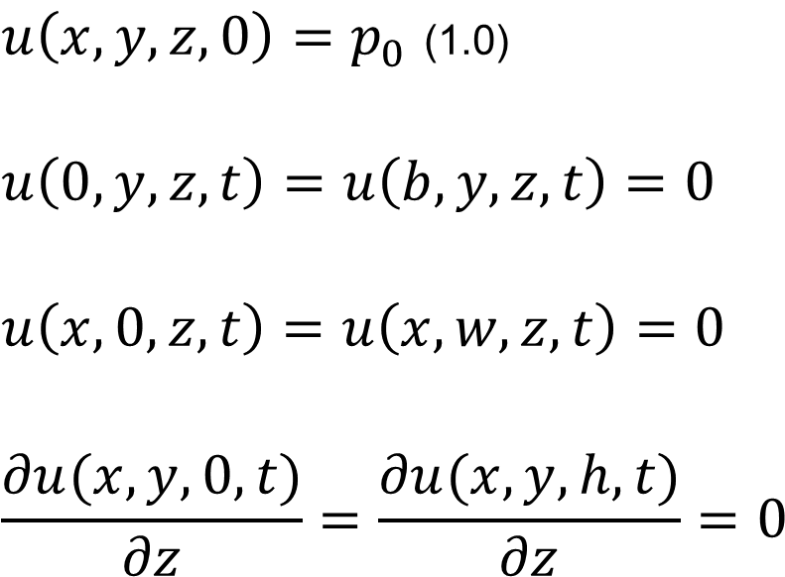
Boundary Conditions
Double Drainage
$u\left(x,y,z,0\right)=p_{0}$ (1.0)
$$u\left(0,y,z,t\right)=u\left(b,y,z,t\right)=0$$
$$u\left(x,0,z,t\right)=u\left(x,w,z,t\right)=0$$
$$\frac{∂u(x,y,0,t)}{∂z}=\frac{∂u(x,y,h,t)}{∂z}=0$$

Slide 22
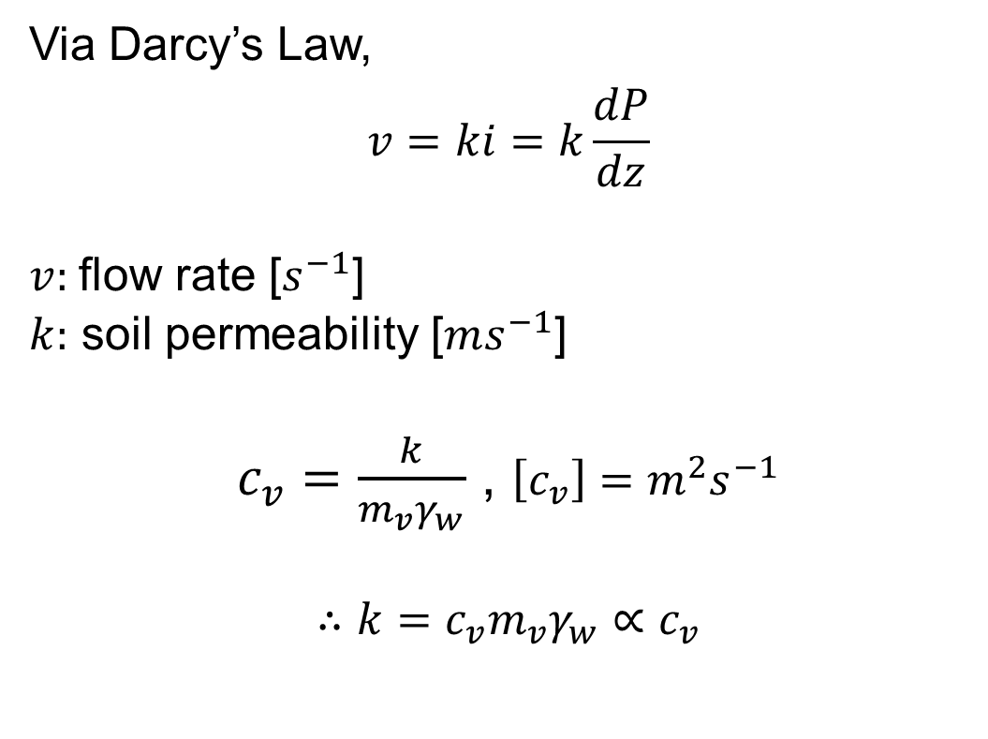
Interface Conditions
Continuity of Flux
$$p_{top}=p\left(z_{int}+ε\right) ; p_{bot}=p\left(z_{int}−ε\right)$$
Via Darcy’s Law,
$$v=ki=k\frac{dP}{dz}$$
$v:$ flow rate [$s^{−1}$]
$k:$ soil permeability [$ms^{−1}$]
$c_{v}=\frac{k}{m_{v}γ_{w}}$ , $\left[c_{v}\right]=m^{2}s^{−1}$
$$∴k=c_{v}m_{v}γ_{w}∝c_{v}$$

Slide 23
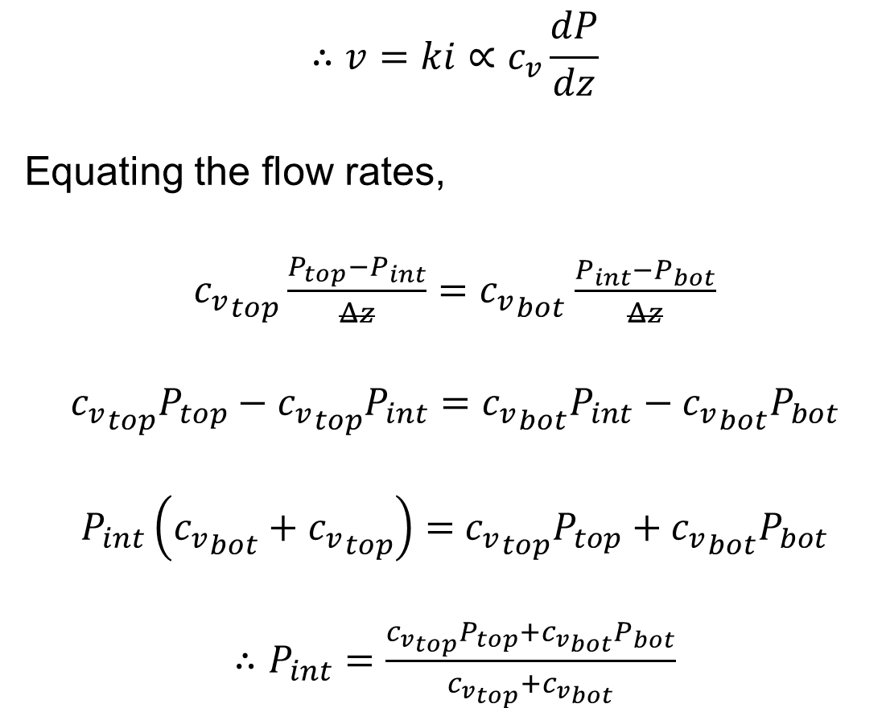
Interface Conditions
Continuity of Flux
$$∴v=ki∝c_{v}\frac{dP}{dz}$$
Equating the flow rates,
${c_{v}}_{top}\frac{P_{top}−P_{int}}{Δz}={c_{v}}_{bot}$ $\frac{P_{int}−P_{bot}}{Δz}$
$${c_{v}}_{top}P_{top}−{c_{v}}_{top}P_{int}={c_{v}}_{bot}P_{int}−{c_{v}}_{bot}P_{bot}$$
$P_{int}\left({c_{v}}_{bot}+{c_{v}}_{top}\right)=$ ${c_{v}}_{top}P_{top}+{c_{v}}_{bot}P_{bot}$
$∴P_{int}=\frac{{c_{v}}_{top}P_{top}+{c_{v}}_{bot}P_{bot}}{{c_{v}}_{top}+{c_{v}}_{bot}}$

Slide 24
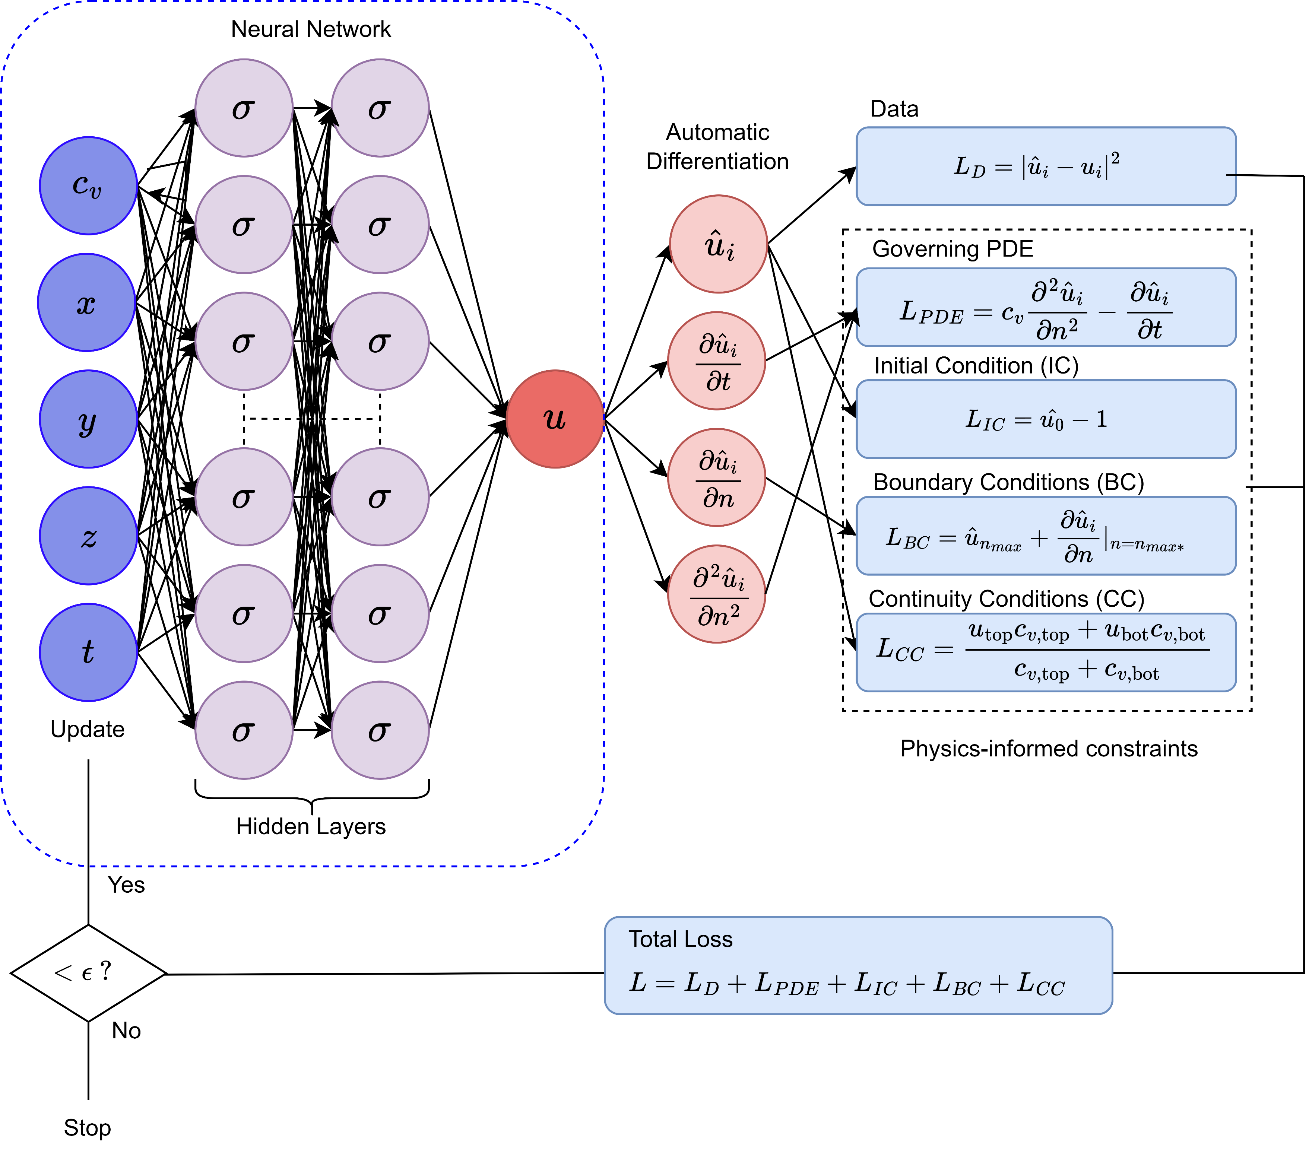
Physics-informed neural network
The model is developed using TensorFlow and Keras backends. There are 4 hidden layers, with 40 neurons in each layer.
We use the ‘tanh’ activation function to introduce non-linearity and ensure values from 0 to 1.

Slide 25
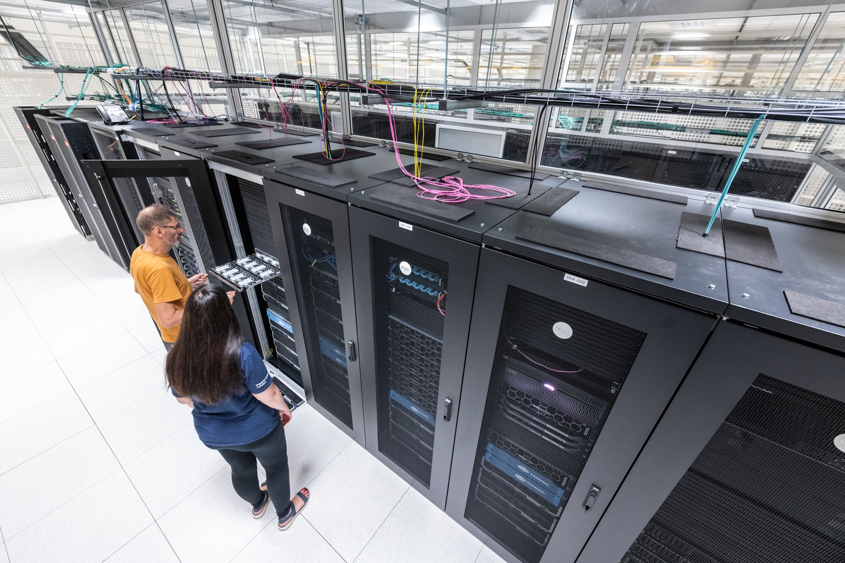
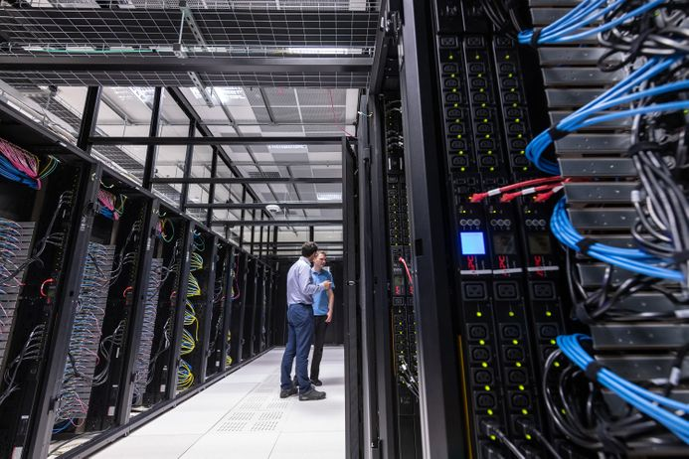
High-Performance Computing at Imperial
What do we use it for?

Slide 26
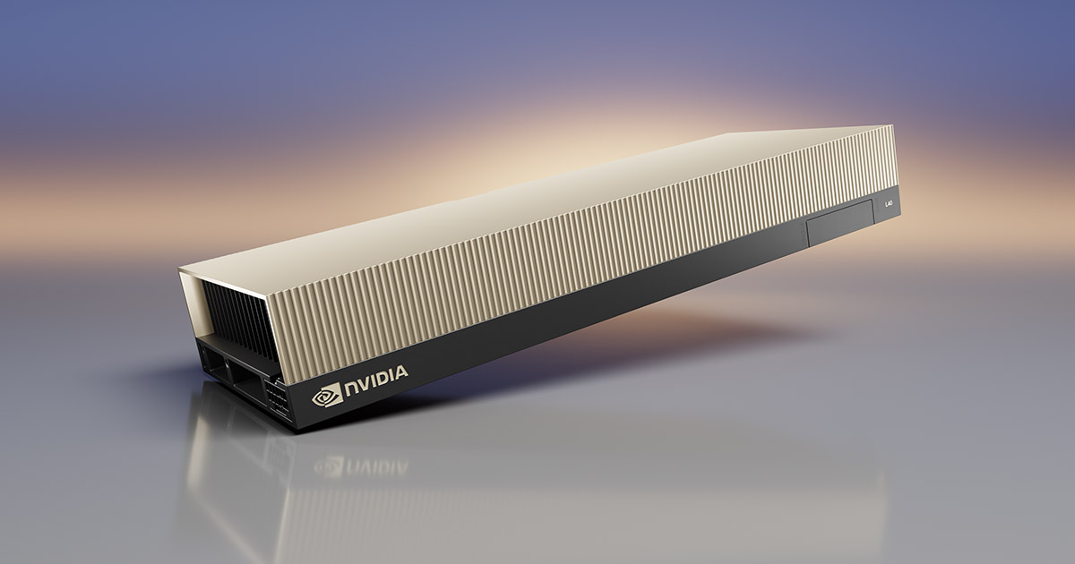
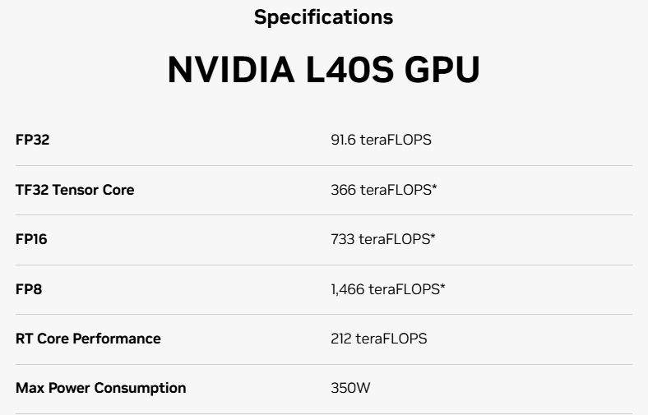
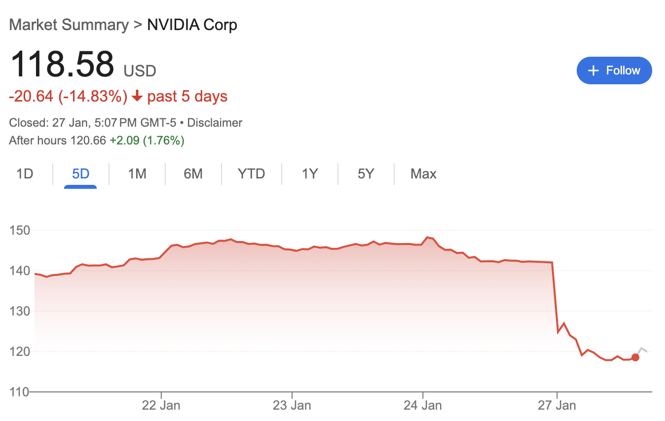
High-Performance Computing at Imperial
Nvidia GPUs
“Modern HPC data centres are key to solving some of the world’s most important scientific and engineering challenges” - Nvidia

Slide 27



High-Performance Computing at Imperial
Submitting batch jobs

Slide 28


Training the Physics-informed Neural Network
Loss Function
The neural network is trained using an L40S GPU for approximately 12 hours.
For reference, training this network using a 6-core CPU (Ryzen 5600x) takes more than 100 hours.
We determine that a suitable loss is around ${10}^{−3}$, such that there is no visible difference between the model’s output and the exact solution.
The model is trained for 25,000 epochs (iterations) with a batch size of 500.
The learning rate of the Adam optimiser is exponentially decayed.

Slide 29

Training the Physics-informed Neural Network
Hyperparameter Tuning
Hyperparameters must be appropriately determined for each problem.
The model architecture can be too complex and not offer any additional accuracy.
There must be a compromise between complexity and training time.

Slide 30


What if I don’t have a GPU?
Transfer Learning
Transfer learning consists of taking features learned on one problem, and leveraging them on a new, similar problem.
It's a way to reuse models and knowledge to address new problems more efficiently.
This has been used in many image classification algorithms. If a model is good at classifying racoons, it can probably be used to classify tanukis.

Slide 31

What if I don’t have a GPU?
Transfer Learning
The neural network is trained initially for 50,000 epochs for the coefficient in the midpoint of the training region
The model is then re-trained for a new coefficient/parameter
Each subsequent training session leads to a lower loss value, with quicker convergence

Slide 32



Results
Pore Pressure Plots
The following plots are outputted from the model for $t=0.5$ years and 1,000,000 samples. The $({c_{v}}_{1}, {c_{v}}_{2},{c_{v}}_{3})$ values are varied over the testing region.
The model can also output a pore pressure for any grid size, or even a single point. The FEM solution would need to compute the entire solution first before evaluating a single point.

Slide 33

Mesh Constraint
FEM solutions are always constrained to a mesh.
If a researcher would like to probe the value at a specific point, they must compute the FEM solution again.

Slide 34


Mesh Constraint

Slide 35


What about one layer?
Three Layers One Layer
Normalised Pore Pressure u/u₀

Slide 36




Comparisons

Slide 37


Slide 38




Execution Times
How long does it take the FEM to evaluate the 1 million data points required for the following plot?
The FEM solution is computed with $N_{t}=5000$, the minimum number of steps to give an ‘acceptable’ solution with similar accuracy
Each method is used to compute a pore pressure solution with a given number of samples, $N$. The root mean squared error (RMSE) is then calculated for each $N.$
The execution times are linearly fitted to extrapolate and predict the time taken for 1 billion samples.
2 hours
How long does it take the PINN?
0.12
seconds

Slide 39


Slide 40



Slide 41

Sensitivity Analysis
The input coefficients are varied singularly for each layer, keeping the other two coefficients constant at 0.05
The RMSE is calculated between the model’s output and the exact solution.
The plot shows that the performance of the model is poor for values further away from the training points, as expected.

Slide 42
Inversion Problem
Predicting the coefficients of each layer in a given solution

Slide 43

Inversion Algorithm
How can we use the model to predict unknown coefficients?
Remember that the model can output pore pressure for any given coefficients!
Therefore, we only need to minimise the MSE error between the model’s output and the given solution as a function of the coefficients.
We use the BFGS method, which is a second order optimization algorithm and works well for more than one variable.
Typical inversion methods, such as Bayesian inversion, requires lots of data to perform. However, this inversion should take seconds.

Slide 44


Inversion
Multi-layered
${c_{v}}_{1}$ accuracy: 96.34%
${c_{v}}_{2}$ accuracy: 99.25%
${c_{v}}_{3}$ accuracy: 97.69%

Slide 45

Inversion
Single-layered
99.7% accurate!

Slide 46
Conclusion
What does this mean for civil engineers?
Our results show that the PINN model can accurately (and quickly) output pore pressure data and predict unknown parameters from exact solution data.
FEM software is typically costly and challenging to learn, while the PINN model can be easily tweaked by Python users for different drainage conditions.
This research can be extended to more realistic and unsymmetrical examples to aid civil engineers in making informed decisions in the real world.

Slide 47

Thank you!
Umar Siddique
15/02/2025

